Slide 1
SMART WEARABLE HAND DEVICE FOR SIGN LANGUAGE INTERPRETATION SYSTEM WITH SENSORS FUSION
Sreelakshmi Hari
Class no:59 s7 Btech CSE
12 SEPTEMBER,2018

Slide 2
CONTENTS
WEARABLE HAND DEVICE FOR SIGN LANGUAGE INTERPRETATION
INTRODUCTION
VISION METHOD
SYSTEM DESIGN
OVERVIEW
METHOD
SIGN CLASSIFIER
RESULT
CONCLUSION
REFERENCES

Slide 3
INTRODUCTION
WEARABLE HAND DEVICE FOR SIGN LANGUAGE INTERPRETATION
Sign language plays a vital role in deaf and mute people.
Languages have been recognized using two major techniques.
Non vision approach
Vision approach

Slide 4
VISION METHOD
WEARABLE HAND DEVICE FOR SIGN LANGUAGE INTERPRETATION
System that uses a camera
This method divided into:
Direct approach
Indirect approach
Affected by image filtering ,color segmentation and background cancellation.
Non-vision approach utilize sensors.
Notes:
Direct based on rgb color spaces of the skin color
Indirect using data glove

Slide 5
INTRODUCTION(Contd..)
WEARABLE HAND DEVICE FOR SIGN LANGUAGE INTERPRETATION
Gestures are identified using
5 flex sensors
2 pressure sensors
IMU sensor
gyroscope sensor
Gestures are recognized using SVM model.
Received through wireless Bluetooth transmission
Text to speech converted into audible form

Slide 6
SYSTEM DESIGN
WEARABLE HAND DEVICE FOR SIGN LANGUAGE INTERPRETATION
Courtesy:https://ieeexplore.ieee.org/document/8314694

Slide 7
HARDWARE DESIGN AND SYSTEM FLOW
WEARABLE HAND DEVICE FOR SIGN LANGUAGE INTERPRETATION
Flex sensors :- omnidirectional and bidirectional sensors.
Bidirectional type is used with each flex sensor is of 10kΩ resistor
Proposed system divided into 3 modules:
Sensor module
Processing module
Application module
Sensor and processing modules : wearable device.
Application module : Android-based mobile device.

Slide 8
OVERVIEW DESIGN
WEARABLE HAND DEVICE FOR SIGN LANGUAGE INTERPRETATION
Courtesy:https://ieeexplore.ieee.org/document/8314694

Slide 9
HARDWARE DESIGN AND SYSTEM FLOW(Contd.)
WEARABLE HAND DEVICE FOR SIGN LANGUAGE INTERPRETATION
Flex sensors and IMU data are collected using an ArduinoPro Mini328.
Data extracted from sensor data and serve to SVM
28 gesture patterns - 26 alphabets ,a neutral state and an invalid sign.
Detected sign is transmitted using Bluetooth module.
Recieved text will display on the screen.
Then text to speech converted into audible form.

Slide 10
METHODS
WEARABLE HAND DEVICE FOR SIGN LANGUAGE INTERPRETATION
Preprocessing
Feature Extraction
Sign classifier

Slide 11
PREPROCESSING
WEARABLE HAND DEVICE FOR SIGN LANGUAGE INTERPRETATION
Flexion values varies among hands
Resistance of flex sensors in smaller hand will have less variation
Sensor values are normalized on computed mean and standard deviation
𝑓𝑠𝑖̂=(𝑓𝑠𝑖−𝑓𝑠̅) / 𝜎𝑓𝑠

Slide 12
PREPROCESSING(Contd..)
WEARABLE HAND DEVICE FOR SIGN LANGUAGE INTERPRETATION
The hand movement derived from the IMU in three orientation:
Pitch
Roll
Yaw
Sign gestures are:
Courtesy:https://ieeexplore.ieee.org/document/8314695

Slide 13
FEATURE EXTRACTION
WEARABLE HAND DEVICE FOR SIGN LANGUAGE INTERPRETATION
The flexion degree is split into three regions
first region -“no bend” or “slight bend,”
second region is considered as a “partial bend”
Last region is a “complete bend”
These regions are abbreviated in order as:
OR
PR
CR

Slide 14
FEATURE EXTRACTION(Contd..)
WEARABLE HAND DEVICE FOR SIGN LANGUAGE INTERPRETATION
Signs exhibit the same regions :
“U” and “V,” “K” and “P,” and “I” and “J,” as well as “G,” “L,” “Q,” and “Z.”
Addition of pressure sensors :two Flexi force pressure sensors used
Surface is pressed ,resistance of a Flexi force pressure sensor is reduced.
The pressure sensors are connected to the digital inputs in processing module
“0” if pressure sensor surface is not pressed
“1” if the pressure is sensed on the surface of the sensor

Slide 15
FEATURE EXTRACTION(Contd..)
WEARABLE HAND DEVICE FOR SIGN LANGUAGE INTERPRETATION
Inclusion of the pressure sensors - solve issues of the letters “U” and “V”
SDs of letter “I” are approximately 0.0369 (pitch), 0.0151 (roll), 0.0375 (yaw)
SDs of letter “J” are 1.3968 (pitch), 0.5603 (roll), and 1.1548 (yaw)
The calculation of each orientation is depending on axis.
𝑎𝑔𝑙𝑖=0.98×(𝑎𝑔𝑙𝑖−1+𝑔𝑦𝑟𝑖/𝑔𝑦𝑟𝐻𝑍)+𝑎𝑔𝑙𝑐𝑖×0.02,
𝑎𝑔𝑙𝑐𝑖= arctan(𝐴𝑢,𝐴𝑣)×180/𝜋

Slide 16
FEATURE EXTRACTION(Cont.)
WEARABLE HAND DEVICE FOR SIGN LANGUAGE INTERPRETATION
𝐴𝑢 and 𝐴𝑣 are denoted as the y-axis and z-axis of accelerometer readings.
Wearable device with fusion of pressure sensor
Courtesy:https://ieeexplore.ieee.org/document/8314694

Slide 17
SVM
WEARABLE HAND DEVICE FOR SIGN LANGUAGE INTERPRETATION
SVM are a set of methods for binary supervised learning
Applicable to both classification and regression problems
SVM classifiers creates maximum-margin hyperplane

Slide 18
LINEAR CLASSIFIERS
WEARABLE HAND DEVICE FOR SIGN LANGUAGE INTERPRETATION
x
f
y
f( x,w ,b ) = sign(w. x - b)
denotes +1
denotes -1
w: weight vector
x: data vector
b: scale value
Courtesy:https://ieeexplore.ieee.org/document/8314664

Slide 19
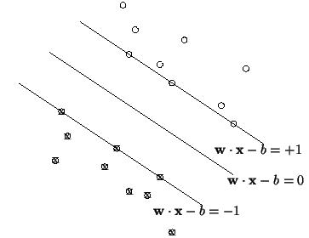
MAXIMUM MARGIN
WEARABLE HAND DEVICE FOR SIGN LANGUAGE INTERPRETATION
The distance between H and H1
w•x+b|/||w||=1/||w||
H1
H
H2
The distance between H1 and H2 : 2/||w||
d+
d-
Maximize the margin, we need to minimize ||w||.
No datapoints between H1 and H2:
x_{i}•w+b ≥ +1 when y_{i} =+1
x_{i}•w+b ≤ -1 when y_{i} =-1
Courtesy:https://ieeexplore.ieee.org/document/8314664

Slide 20
SIGN CLASSIFIER
WEARABLE HAND DEVICE FOR SIGN LANGUAGE INTERPRETATION
The SVM is trained using the “leave one subject out” (LOO) method.
SVM is trained using n – 1 subject datasets, n is the total number of subjects.
The accuracy of each trained model is computed as
𝐴𝐶=𝑇𝑃+𝑇𝑁 / 𝑇𝑃+𝑇𝑁+𝐹𝑃+𝐹𝑁
𝑇𝑃, 𝑇𝑁 - are true positive, true negative.
𝐹𝑃, and 𝐹𝑁 - false positive and false negative respectively.

Slide 21
SIGN CLASSIFIER(Cont.)
WEARABLE HAND DEVICE FOR SIGN LANGUAGE INTERPRETATION
LOO method is best to utilize for model training
It is suitable method to estimate the risk when learning a model.
SUBJECT SAMPLE SIZE((TP + TN) / Total) AC (%)
1st version 425,736 / 648,000 65.7
2nd version 636,336 / 648,000 98.2

Slide 22
RESULT
WEARABLE HAND DEVICE FOR SIGN LANGUAGE INTERPRETATION
when two pressure sensors data is used
Mean AC of ”U” of 57.25% to 97.52%
Mean AC of “R” increased from 57.78% to 97.28%
Mean AC of “V” increased from 57.22% to 97.49%
.
Inclusion of pressure sensor surface showed differences for “U” and “V.”
.

Slide 23
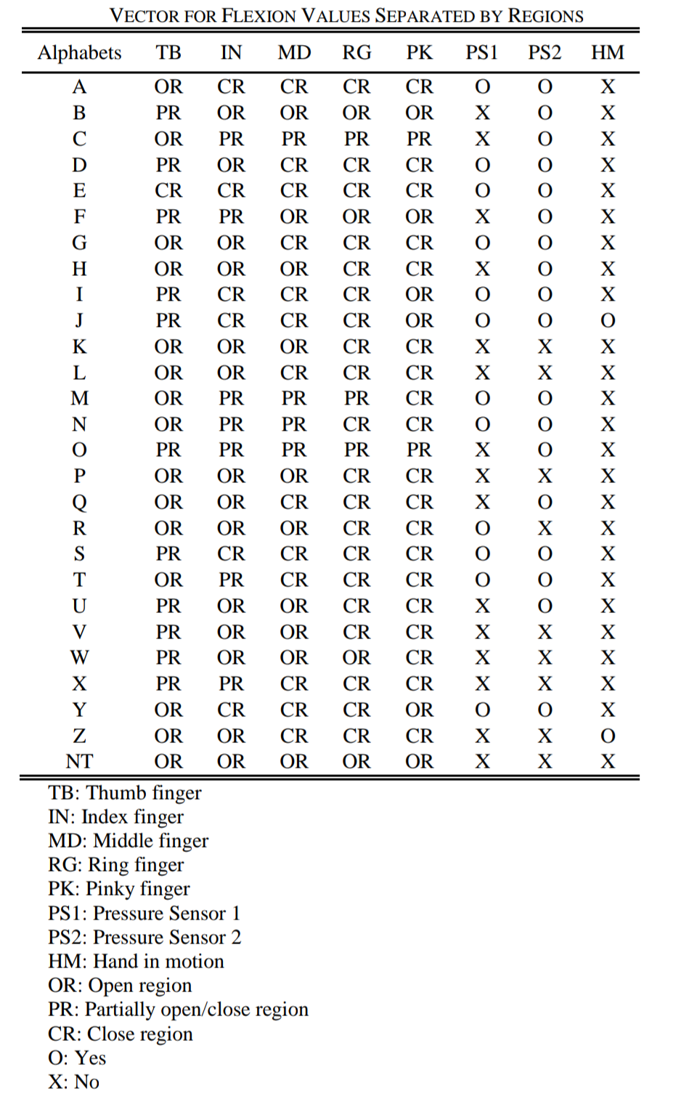
RESULT(Cont.)
WEARABLE HAND DEVICE FOR SIGN LANGUAGE INTERPRETATION
Courtesy:https://ieeexplore.ieee.org/document/8314664

Slide 24
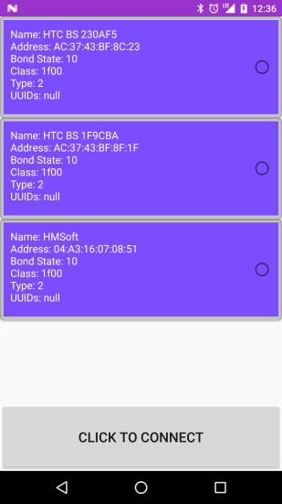
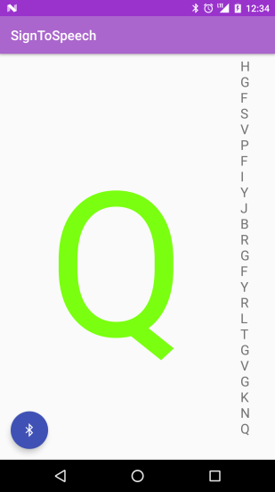
SIGN INTERPRETATION
WEARABLE HAND DEVICE FOR SIGN LANGUAGE INTERPRETATION
Courtesy:https://ieeexplore.ieee.org/document/8314694

Slide 25
CONCLUSION
WEARABLE HAND DEVICE FOR SIGN LANGUAGE INTERPRETATION
Android mobile application was developed for text-to-speech service.
Comfort
Flexible
Eliminating the necessity of custom-made devices

Slide 26
REFERENCES
WEARABLE HAND DEVICE FOR SIGN LANGUAGE INTERPRETATION
J. Wang and T. Zhang, “An ARM-based embedded gesture recognition system using a data glove,” presented at the 26th Chinese Control and Decision Conf., Changsha, China, May 31 - June2, 2014.
A. Z. Shaker, M. F. Miskon, M. H. Jamaluddin, F. A. Ibrahim, M. F. Asyraf and M. B. Bahar, “A new data glove approach for Malaysian sign language detection,” Procedia Comput. Sci., vol. 76, no. 1, pp. 60-67, Dec. 2015.
N. Sri ram and M. Nithiyanandham, “A hand gesture recognition based communication system for silent speakers,” presented at the Int. Conf. Human Comput . Interact., Chennai, India, Aug. 23-24, 2013.
J. Galka , M. Masior , M. Zaborski, K. Barczewska, “Inertial motion sensing glove for sign language gesture acquisition and recognition,” IEEE Sensors J., vol. 16, no. 16, pp. 6310-6316, Aug. 2016.
X. Cai, T. Guo, X. Wu and H. Sun, “Gesture recognition method based on wireless data glove with sensors,” Sensor Letters, vol. 13, no. 2, pp. 134-137, Feb. 2015.

Slide 27
REFERENCES(Contd..)
WEARABLE HAND DEVICE FOR SIGN LANGUAGE INTERPRETATION
6. K. Liu, C. Chen, R. Jafari and N. Kehtarnavaz, “Fusion of inertial and depth sensor data for robust hand gesture recognition,” IEEE Sensors J., vol. 14, no. 6, pp. 1898-1903, Jun. 2014.
7. K. W. Kim, M. S. Lee, B. R. Soon, M. H. Ryu and J. N. Kim, “Recognition of sign language with an inertial sensor-based data glove,” Technol. Health Care, vol. 24, no. 1, pp. 223-230, 2016.
8. L. Sousa, J. M. F. Rodrigues, J. Monteiro, P. J. S. Cardoso and R. Lam, “GyGSLA: a portable glove system for learning sign language alphabet,” presented at Int. Conf. Universal Access in Human-Comput. Interact., Toronto, ON, Canada, Jul. 17-22, 2016.
9. N. Caporusso, L. Biasi, G. Cinquepalmi, G. F. Trotta and A. Brunetti, “A wearable device supporting multiple touch- and gesture-based languages for the deaf-blind,” presented at Int. Conf. Appl. Human Factors and Ergonomics, LA, CA, USA, Jul. 17-21 2017.
10. Z. Yu, X. Chen, Q. Li, X. Zhang and P. Zhou, “A hand gesture recognition framework and wearable gesture-based interaction prototype for mobile devices,” IEEE Trans. Human-Mach. Syst., vol. 44, no. 2, pp. 293-299, Apr. 2014.

Slide 28
THANK YOU

